Slide 1

Change “AMCCAO” into “Sub-seasonal Forecasts of Cold Air Outbreaks”.

Slide 2
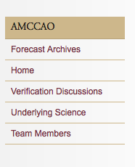
About Us
Mission
Team Members
Forecast Archives
This week’s Forecasts
Northern Hemisphere 2015-2016 Winter
Northern Hemisphere 2014-2015 Winter
Underlying Science
Linkage of continental scale cold air outbreaks to stratospheric circulation variability
Sub-seasonal predictability of the stratosphere
Process flow of the hybrid paradigm for sub-seasonal forecasts of continental scale cold air outbreaks in mid-latitudes.
Publications

Slide 3
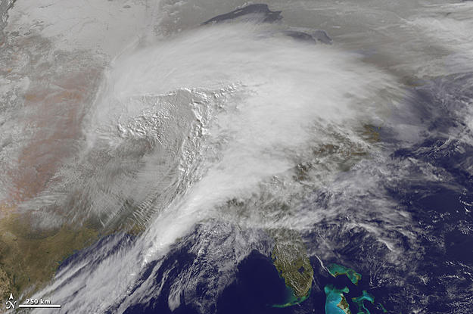
About Us
Mission
What we do: We are making sub-seasonal forecasts for the time periods of high probability of individual cold air outbreak events in Eurasia and North America 30-40 days in advance. We issue such forecasts on a weekly basis and this website is updated around Thursday each week.
Foundation of this work:
GFDI history. has a mission to promote and stimulate theoretical, numerical, field, and laboratory experimental studies of fluid-dynamical phenomena in the atmosphere, rivers and lakes, ground water, oceans, fluids on other planets, and fluid portions of the Earth's interior, and to apply this knowledge to problems in the geosciences, including environmental problems."highly unique in that regard (To be continued!)

Slide 4
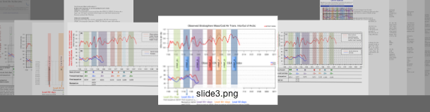

Forecast Archives
This week’s Forecasts
Northern Hemisphere 2015-2016 Winter
Northern Hemisphere 2014-2015 Winter
Update automatically with amccao.com
Display Effects for forecast archives of 2015-2016, 2014-2015 winters
Northern Hemisphere 2015-2016 Winter
Issues:
1. Two reports in this year have not been added to the website.
2. Archives need calendar figure as well!

Slide 5
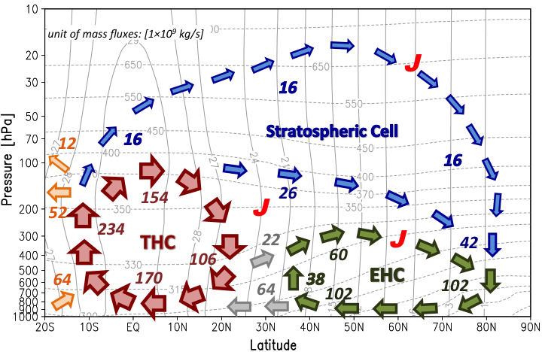
Underlying Science
Linkage of the cold air outbreaks to stratospheric circulation variability
Two-way dynamical coupling mechanisms between the stratosphere and troposphere in the extratropics:
(i) The systematic downward propagation of geopotential height and zonal wind anomalies in the extratropics;
(Kodera and Kuroda 1990; Baldwin and Dunkerton 1999; Baldwin and Dunkerton 2001; Cai and Ren 2007; Ren and Cai 2007)
(ii) The delayed feedbacks of the stratosphere to the upward propagation of tropospheric Rossby waves;
(Hartley et al. 1998; Limpavusan and Hartmann 2002; Ambaum and Hoskins 2002; Polvani and Waugh 2004; Kuroda 2008)
(iii) The downward control principle and with transient eddy feedbacks;
(Haynes et al. 1991; Song and Robinson 2004)
(iv) The reflection of planetary waves;
(Perlwitz and Harnik 2003)
(v) The invertibility principle of potential vorticity.
(Hartley et al. 1998)
Figure 1. Atmospheric meridional mass circulation in isentropic levels. The mass circulation quantifies the net transport of air mass of different entropy in a given latitude band. Solid contours and numbers indicate the winter DJF mean mass transport (units: 10⁹ kg s⁻¹) in each branch of the mass circulation and dashed contours indicate the isentropic levels (units: K) in pressure coordinate. By definition, mass transport along isentropic level is purely due to adiabatic processes, and mass transport across isentropic levels is due to diabatic heating/cooling. (Johnson 1989; Cai and Shin 2014)
Notes:
All references need hyperlink!

Slide 6
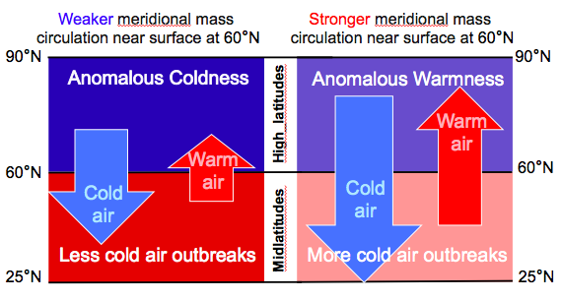
Underlying Science
Linkage of the cold air outbreaks to stratospheric circulation variability
Our forecasts for cold air outbreaks in winter season are based on the relationship of the atmospheric mass circulation and cold air outbreaks.
The atmospheric poleward mass circulation aloft into the polar region, including the stratospheric component, is coupled with the equatorward mass circulation out of the polar region in the lower troposphere, driven by the amplification of large-scale waves in the midlatitudes. The strengthening of the equatorward branch of mass circulation is directly responsible for cold air outbreaks in mid-latitudes (as shown in Fig. 2). There exist two dominant geographical patterns of temperature anomalies during the cold air discharge period (or 1–10 days after a stronger mass circulation across 60°N). One is the mean geographical patterns of surface air temperature anomalies associated with the intensity of mass circulation, representing cold anomalies mainly in the midlatitudes of both North America and Eurasia (Fig. 3), and the other represents cold anomalies mainly over only one of the two continents accompanied with abnormal warmth over the other continent.
Figure 2. Schematic figure for the relation between the intensity of mass circulation near polar circle and surface air temperature variability in high- and mid- latitudes.

Slide 7
Figure 3. Temporal evolution of composite surface air temperature anomalies in the period from 10 days before to 10 days after the dates when the poleward branch of the atmospheric meridional mass circulation in upper isentropic levels transports at least half standard deviation below (left panel) and above (right panel) normal air mass into the polar region.

Slide 8
References:
Johnson, D. R., 1989: The forcing and maintenance of global mon- soonal circulations: An isentropic analysis. Adv. Geophys., 31, 43-31.
Yu, Y-Y, M. Cai, R.-C. Ren, and H. van den Dool, 2015a: Relationship of warm air mass transport into upper polar atmosphere and cold air outbreaks in winter. J. Atmos. Sci., 72, 349–368.
Yu, Y-Y, R.-C. Ren, and M. Cai, 2015b: Dynamical linkage between cold air outbreaks and intensity variations of the meridional mass circulation. J. Atmos. Sci., 72，3214-3232.
Yu, Y-Y, R.-C. Ren, and M. Cai, 2015c: Comparison of the mass circulation and AO indices as indicators of cold air outbreaks in northern winter. Geophys. Res. Lett., 42, 2442–2448.
Cai, M., and C-S Shin, 2014: A Total Flow Perspective of Atmospheric Mass and Angular Momentum Circulations: Boreal Winter Mean State. J. Atmos. Sci., DOI:10.1175/JAS-D-13-0175.1.
Zhang, Q., C-S Shin, H. van den Dool, and M. Cai, 2013: CFSv2 Prediction Skill of Stratospheric Anomalies. Clim. Dyn. DOI:10.1007/s00382-013-1907-5.
Ren, R-C and M. Cai, 2008: Meridional and downward propagation of atmospheric circulation anomalies. Part II: Southern Hemisphere cold season variability. J. Atmos. Sci., 65, 2343-2359.
Ren, R-C, and M. Cai, 2007: Meridional and vertical out-of-phase relationships of temperature anomalies associated with the NAM variability. Geophys. Res. Lett. , 34, L07704, doi:10.1029/2006GL028729.
Cai, M., and R-C Ren, 2007: Meridional and downward propagation of atmospheric circulation anomalies. Part I: Northern Hemisphere cold season variability. J. Atmos. Sci., 64, 1880-1901.
Kodera and Kuroda 1990; Baldwin and Dunkerton 1999; Baldwin and Dunkerton 2001; Cai and Ren 2007; Ren and Cai 2007)
(Hartley et al. 1998; Limpavusan and Hartmann 2002; Ambaum and Hoskins 2002; Polvani and Waugh 2004; Kuroda 2008)
(Haynes et al. 1991; Song and Robinson 2004)
(Perlwitz and Harnik 2003)
(Hartley et al. 1998)

Slide 9
Sub-seasonal predictability of the stratosphere
Underlying Science
Due to the inherent predictability limit of 1-2 weeks for numerical weather forecasts, operational numerical weather forecast models no longer have useful forecast skill for weather forecasts beyond a lead time of about 10 days.
With more satellite data in the stratosphere to assimilate and increased vertical resolution, we now have the capability to use numerical weather prediction (NWP) models as an initial value problem for stratospheric forecasts in the extratropics with a useful skill in the sub-seasonal range (e.g., Tripathi et al. 2014 for extreme polar vortex events; Christiansen 2005, Charlton and Polvani 2007, and Yoden et al. 2014 for major stratospheric sudden warming events; Marshall et al. 2009 for a rare volcanic eruption event; Stan and Straus 2009, Li and Ding 2011, and Zhang et al. 2013 for zonal mean temperature, geopotential height, and wind anomalies; Cai et al. 2015 for PULSE events of warm air mass transported into the polar stratosphere above isentropic level 400K).
The stratosphere is more predictable than the troposphere because:
Stratosphere has longer persistent time scale from the dominance of the quasi-stationary planetary scale Rossby waves over the fast moving synoptic scale waves, which is the conventional wisdom;
The useful skill for sub-seasonal forecasts in extratropical stratosphere is due to the models’ ability to retain amplitude of planetary waves throughout the sub-seasonal range, despite that the models may not be able to predict the exact locations of planetary waves and their spatial scales beyond the 2-week range.
References:
Tripathi et al. 2014 for extreme polar vortex events; Christiansen 2005, Charlton and Polvani 2007, and Yoden et al. 2014Marshall et al. 2009;Stan and Straus 2009, Li and Ding 2011, and Zhang et al. 2013Cai et al. 2015

Slide 10
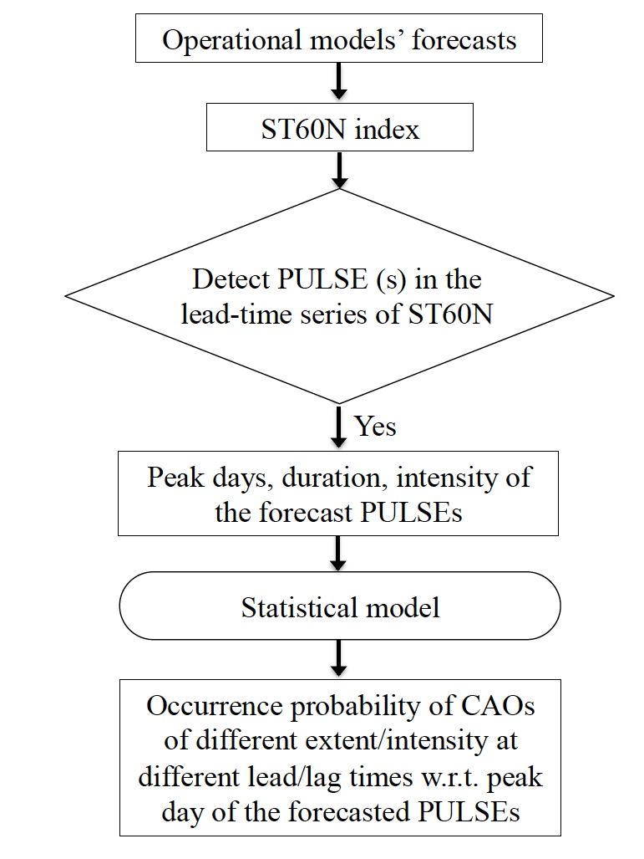
The process flow of the proposed hybrid paradigm for sub-seasonal forecasts of continental scale cold air outbreaks in mid-latitudes.
We calculate stratospheric mass transport into the polar region from forecast outputs of the US NOAA NCEP's operational CFSv2 model and use it as our forecasts for the strength of the atmospheric mass circulation, which is called ST60N index. The anomalous strengthening of it is indicative of the high probability of occurrence of cold air outbreaks in mid-latitudes.
Because cold air outbreak events are accompanied with development of low and high pressure system and frontal circulations, our forecasts of cold air outbreaks are also indicative of snow, frozen rain, high wind, icy/freezing and other winter storm related hazards besides a large area of below-normal cold temperatures.
Figure 4. The flow chart of the prototype hybrid (dynamical plus statistical) paradigm for real time sub-seasonal forecasts of continental-scale CAOs in mid-latitudes

Slide 11
Publications
Yu, Y-Y, M. Cai, R.-C. Ren, and H. van den Dool, 2015a: Relationship of warm air mass transport into upper polar atmosphere and cold air outbreaks in winter. J. Atmos. Sci., 72, 349–368.
Yu, Y-Y, R.-C. Ren, and M. Cai, 2015b: Dynamical linkage between cold air outbreaks and intensity variations of the meridional mass circulation. J. Atmos. Sci., 72，3214-3232.
Yu, Y-Y, R.-C. Ren, and M. Cai, 2015c: Comparison of the mass circulation and AO indices as indicators of cold air outbreaks in northern winter. Geophys. Res. Lett., 42, 2442–2448.
Cai, M., and C-S Shin, 2014: A Total Flow Perspective of Atmospheric Mass and Angular Momentum Circulations: Boreal Winter Mean State. J. Atmos. Sci., DOI:10.1175/JAS-D-13-0175.1.
Zhang, Q., C-S Shin, H. van den Dool, and M. Cai, 2013: CFSv2 Prediction Skill of Stratospheric Anomalies. Clim. Dyn. DOI:10.1007/s00382-013-1907-5.
Ren, R-C and M. Cai, 2008: Meridional and downward propagation of atmospheric circulation anomalies. Part II: Southern Hemisphere cold season variability. J. Atmos. Sci., 65, 2343-2359.
Ren, R-C, and M. Cai, 2007: Meridional and vertical out-of-phase relationships of temperature anomalies associated with the NAM variability. Geophys. Res. Lett. , 34, L07704, doi:10.1029/2006GL028729.
Cai, M., and R-C Ren, 2007: Meridional and downward propagation of atmospheric circulation anomalies. Part I: Northern Hemisphere cold season variability. J. Atmos. Sci., 64, 1880-1901.
All the references in the website should have hyperlink, making it easier to download and read the related papers.

